Slide 1
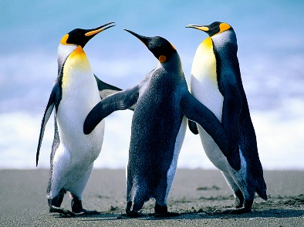
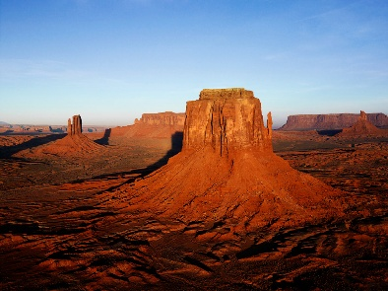
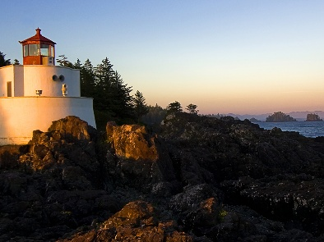
ISHAN TRAVELS
WE THE PREFIX,ISHAN TRAVELS IS WORKING SINCE 1990, PROVIDING YOU THE BEST EXPERINCE OF THE WORLD.WE MOULD EXPERIENCES.
SHIMLA(MINI SWITZERLAND),KULU,MANALI,ROTANG,DALHOUSIE,AMRITSAR.
RAJASHTAN-JAYPUR,BIKANER,JESALMER,JODHPUR
SP. NEPAL,POKHAR,BANARAS,ALLAHABAD,KATMANDU

Slide 2

ISHAN TRAVELS
SHIMLA(MINI SWITZERLAND),KULU,MANALI,ROTANG,DALHOUSIE,AMRITSAR.
SHIMLA, THE WHITE CITY. SHIMLA IS KNOWN AS MINI SWITZERLAND OF INDIA BECAUSE IT IS AS COLD AND AS BEAUTIFUL AS SWITZERLAND.
MANALI,THIS HILL STATION IS LOCATED NEAR THE BANK OF BIYAS RIVER,IT IS SO BEAUTIFUL AND COLD HILL STATION.
KULU,VAISHNAVDEVI MANDIR IS LOCATED TERE AND SHOPPING OF SHOWEL AND RIVER RAFTING.
DALHOUSIE,IT IS KHONK FOR THE LORD DALOUSIE’S NAME.
AMRITSAR,SHOPPING,IND/PAK WAGHA BORDER(LAKSHARI PARADE), GOLDEN TEMPLE VISIT.
ROTANG,THE PLACE WITH BEAUTIFUL MOUNTAIN AND COVERED WITH SNOW.

Slide 3

ISHAN TRAVELS
RAJASHTAN-JAYPUR,BIKANER,JESALMER,JODHPUR
JAYPUR,JAYPUR IS KNOWN AS PINK CITY OF INDIA.PLACES-AAMER FORT,BIRLA MANDIR,KANAK GARDEN,ETC ARE THE BEST EXAMPLES OF THE ARTS OF RAJASTHAN.
BIKANER,JUNAGARH FORT,KARANIMATA MADIR VISIT, SWECHHA VIHAR.
JESALMER,JESALMER IS KHOWN AS GOLDEN CITY OF RAJASTHAN FAMOUS HISTORICAL BUILDINGS.
JODHPUR,JODHPUR IS KHOWN AS SUNCITY OF RAJASTHAN. VISIT-UMEDBHAVAN VISIT.

Slide 4
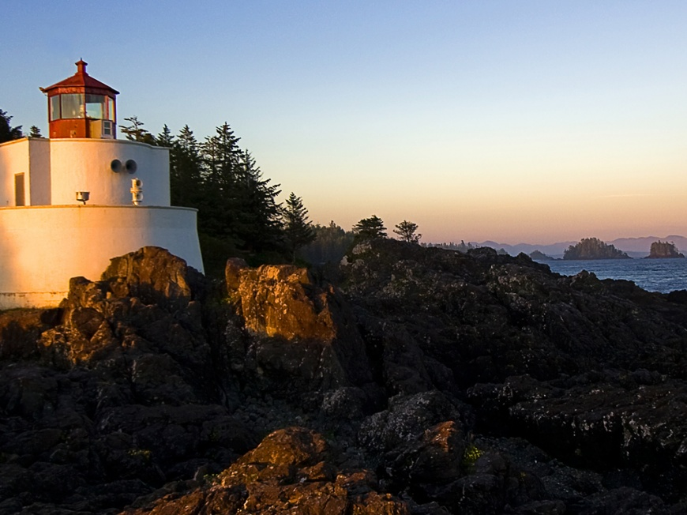
ISHAN TRAVELS
SP. NEPAL,POKHAR,BANARAS,ALLAHABAD,KATMANDU
NEPAL,GOING TO FAMOUS NEPALI CASINO-OWN RESPONSIBILITIES.
POKAR,THE CITY WITH SNOW AND YAK RIDING.
BANARAS,THE CITY WITH FULL OF JOY ANDIT ALSO KNOWN AS COLOURFUL CITY BY VISITORS.
KATMANDU,VERY FAMOUS PASHUPATINATH MANDIR DARSHAN,BUDDHA MANDIR NILKANTH MANDIR,BODDH MATH OR NAPALI WORLD CASINO.
ALLAHABAD,THE METTING OF THREE RIVERS-THE GANGA,THE YAMUNA,AND THE SARASWATI KNOWN AS PRAYAG OR TIVENI SANGAM.

Slide 5
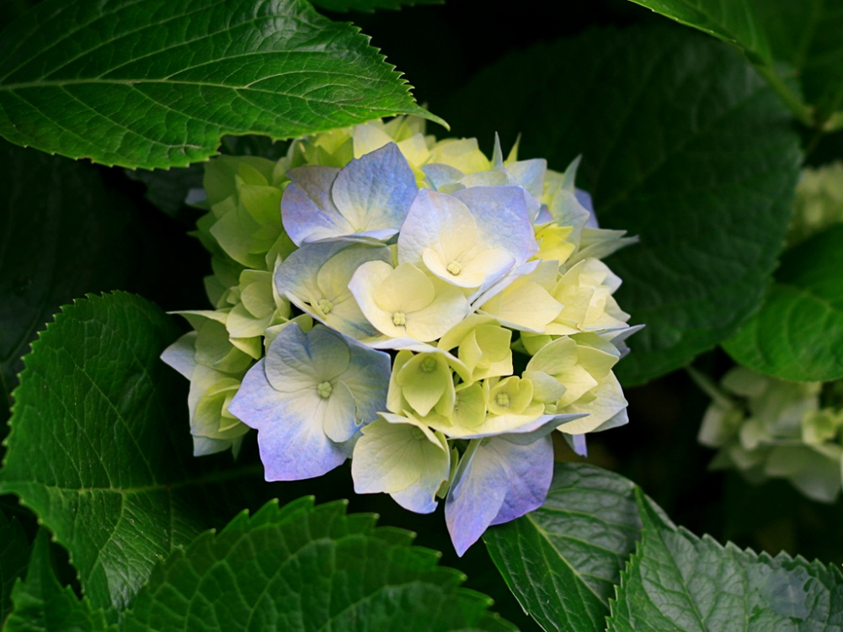
ISHAN TRAVELS
MAHABLESHVAR,GOA,LONAVALA,KHANDALA,IMAGICA
MAHABALESHVAR,THE BEAUTIFUL CIYT WITH BEAUTIFUL PLACES,DIFFERENT GREENARY AND VALLEYS.
GOA,THE PLACE WITH SO MANY BEAUTIFUL BEACHES,THE HIGHEST TOURIST ACTIVITY PLACE OF INDIA.
LONAVALA,THE LIKELY PLACE WITH SO MANY DIFFERENT TYPES OF ADVENTURE ACTIVITIES AND GREEN JUNGLES.
KHANDALA,THE PLACE WHERE THE TOURISTS CAME TO SEE ONLY THE ORANGE SUN SETTING.
IMAGICA,BEAUTIFUL AMUSMENT PARK LOCATED NEAR MUMBAI.WITH SO MANY BEAUTIFUL RIDES AND SO MANY DUFFERENT THEATRES AND IT IS INDIA’S MOST FAVOURITE THEME PARK WHERE THE MOST PUBLIC CAME.

Slide 6
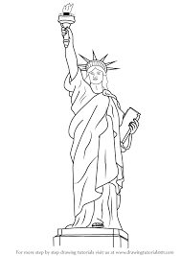
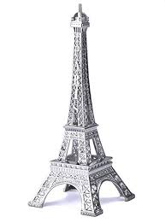
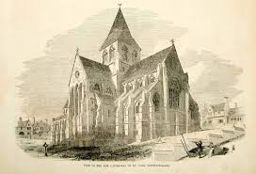
Summer Trip Holiday Package
ISHAN TRAVELS
USA, WASHINGTON ,STATUE OF LIBERTY,WHITE HOUSE.
PARIS,EFFIL TOWER ,SMURF’S VILLAGE, DISNEYLAND OF PARIS.
CANADA, THE SNOW SKIES, WORLD’S MOST ANCIENT CHURCH .

Slide 7
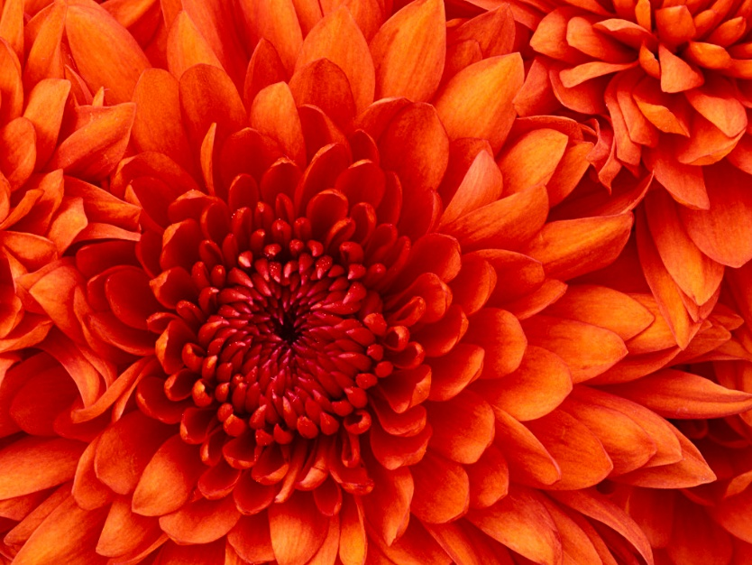
ISHAN TRAVELS
IF YOU ARE IERESTED IN ABOVE TRIPS THEN PLEASE WLCOME AN CONTACT US.
MO. :9827645732
IF YOU ARE INTERESTED THEN COME TO OUR OFFICE AND YOU WILL BE GIVEN FULL DETAILS BY OUR CEO:JAGANI ISHAN

